Slide 1
M S Ramaiah Institute of Technology
(An Autonomous Institute,Affiliated to VTU)
MSR Nagar, MSRIT post, Bangalore-54
DEPARTMENT OF COMPUTER SCIENCE & ENGINEERING
Paper Presentation on –Smart Helmet for Bike
Submitted by
Saddam hussain 1MS13CS418
Anil Pawar 1MS13CS400
Darshan K P 1MS13CS420
Sreekanth Nayak 1MS12CS023

Slide 2
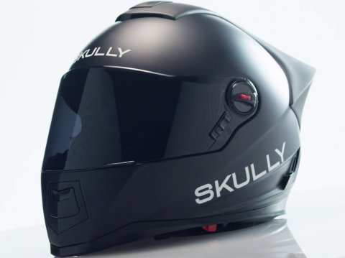
Smart Helmet for Bike

Slide 3
Contents
Introduction
Project Goals
Description about Sensors (IOT)
Progress of the Project
Description about the SRS
Description about the Design
Implementations Details
Results
Conclusion and Future work
Bibliography

Slide 4
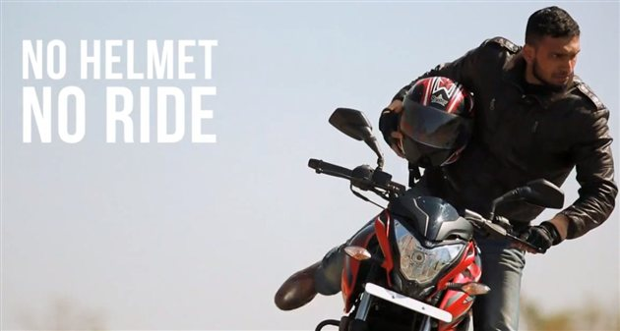
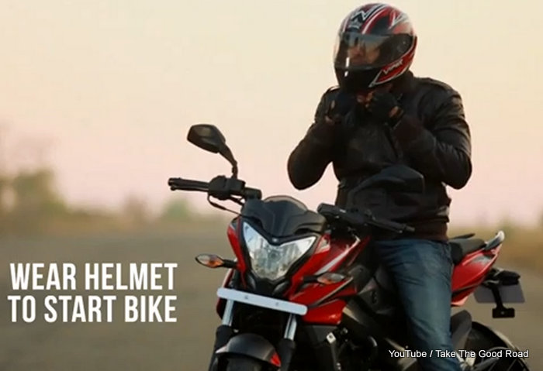
Introduction

Slide 5
Interfacing alcohol detection equipment with helmets and the helmet is connected to bike wirelessly this project aims to prevent drunk and drive.
Also the helmet is equipped with sensor to detect if person is not wearing the helmet. If person is drunk or not wearing the helmet then the bike will not start.
The helmet is equipped with microcontroller and connected with alcohol detection sensor and obstacle sensor.

Slide 6
Project Goals
To design a smart helmet and integrate with bike.
helmet will detect if a person or rider is consumed alcohol.
This prevents accidents due to alcoholism.
It will signal the bike and bike engine will be stopped.
The obstacle sensor will detect if the person is wearing the helmet or not.

Slide 7
Description about Sensors (IOT)
Alcohol Detection sensor
Obstacle sensor

Slide 8
Alcohol Detection sensor
Alcohol Sensor is a complete alcohol sensor module for Arduino or Seeeduino. .
It has good sensitivity and fast response to alcohol.
It is suitable for making Breathalyzer.

Slide 9
Obstacle sensor
Obstacle sensor is IR based
The obstacle sensor will detect if the person is wearing the helmet or not.
This output is give to logic circuit to indicate the Bike start or Stop.

Slide 10
Progress of the Project
Understanding the use of raspberry pi board.
Understanding the functions of sensors used in the project.
Configuring the hardware's.
Understanding the working of circuit diagram.
Understanding the working of the project
Finally we prepare to present the paper

Slide 11
Description about the SRS
1. External Interface Requirements
1.1 User Interfaces
1.2 Hardware Interfaces
1.3 Software Interfaces
1.4 Communication Interfaces
2. Functional Requirements

Slide 12
3. Software System Attributes 3.1 Reliability 3.2 Availability 3.3 Security
4. Performance Requirements 4.1 Portability 4.2 Maintainability 4.3 Performance
5. Design Constraints
6. Other Requirements

Slide 13
Description about the Design
Design includes two modules:
Helmet Unit
Vehicle Unit

Slide 14
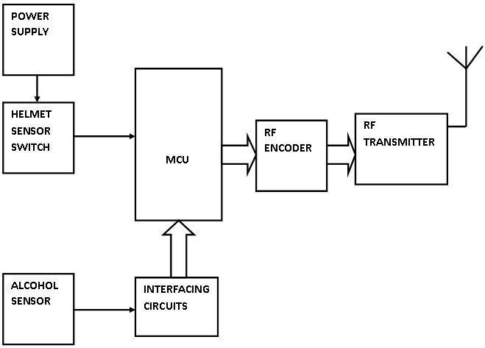
Helmet Unit:

Slide 15
Helmet Unit:
This module consists of various sensors and a transmitter circuitry.
Two sensors have been used, namely alcohol sensor
and obstacle sensor.
Alcohol sensor has been used to detect the alcohol concentration. The alcohol sensor will be placed near the mouth of the rider, inside the helmet. and obstacle sensor is put on the head to detect whether rider wear helmet or not. The RF transmitter transmits the data from the microcontroller on the helmet side to the receiver on the vehicle side

Slide 16
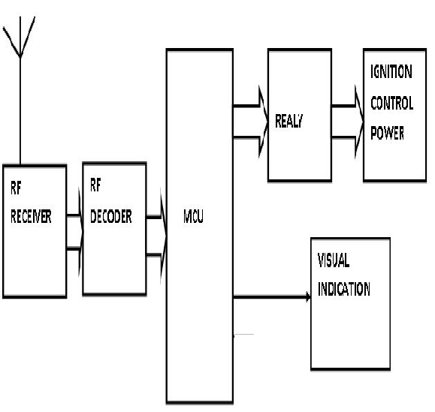
Vehicle Unit

Slide 17
Vehicle Unit:
This module consists of RF receiver, relay switch. The RF receiver receives the data and sends it to the microcontroller for further processing.
Microcontroller receive these signal status and convert it into command for operating the relay switch to control on and off operations in bike engine. status is controlled by the microcontroller depending on various conditions such as wearing of helmet, alcohol concentration level.

Slide 18
Implementation Details
Implementation using Raspberry Pi Board
The Raspberry Pi is a series of credit card-sized single-board computers developed in the UK by the Raspberry Pi Foundation with the intention of promoting the teaching of basic computer science in schools.

Slide 19
Implementation using Alcohol sensor
The helmet will contain an ARM-7 controller like Raspberry Pi board.
The microcontroller will be connected with alcohol detection sensor using GPIO pins.
The bike will have another microcontroller is interfaced with engine start stop function.
The helmet mounted microcontroller is connected with bike using either Wi-Fi or Bluetooth devices

Slide 20
Implementation using Obstacle sensor
The helmet mounted controller is connected to obstacle sensor
It Will detect if person is wearing the helmet or not prior to starting the bike.
The controller mounted on bike will wait for the signal from helmet mounted controller before starting the engine.

Slide 21
Results
When the alcohol consumption by rider then the alcohol sensor will detect and it will stop the bike.
When driver didn’t use the helmet then Obstacle sensor detects that the driver is not wearing helmet, bike will stop and also applies the brake.

Slide 22

Conclusion
As the concluding part of this project, I would like to say that-- "Without proper action at proper time, danger awaits us with a bigger face." We must act on time when a person is injured. We must take care of person the way it is meant. Otherwise, a valuable life might be lost .We need to understand how precious lives of people are and what importance first-aid carries in saving these precious lives.
If this project imparts this idea in even one person, I would think that the project will be successful.

Slide 23
Future work
It can be used in real time safety system.
We can implement the whole circuit into small module later.
Less power consuming safety system.
This safety system technology can further be enhanced into four wheeler also by replacing the helmet with seat belt.

Slide 24
Bibliography
http://wiringpi.com/download-and-install/
http://www.gtk.org/download/linux.php
https://www.raspberrypi.org/documentation/usage/gpio-plus-and-raspi2/

